Slide 1
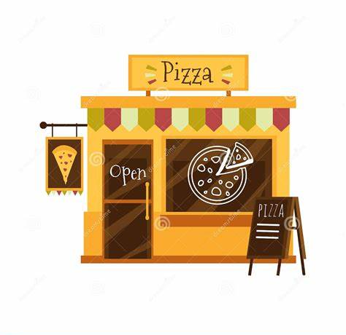
PIZZA SALES
ANALYSIS
JANUARY 2015 – DECEMBER 2015

Slide 2
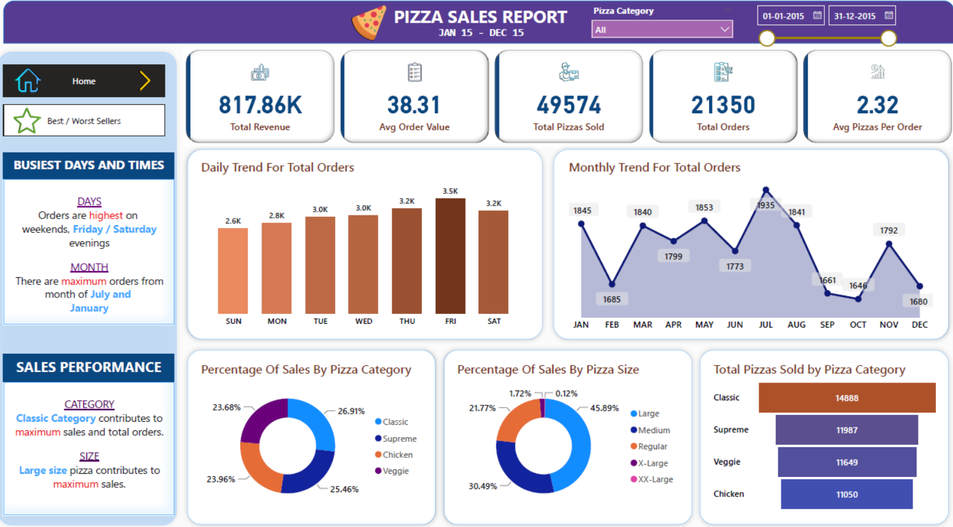

Slide 3
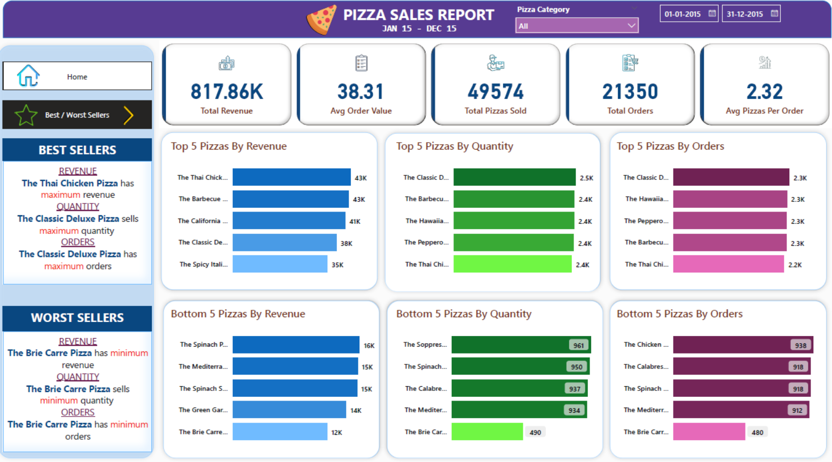

Slide 4
INSIGHTS
The pizza menu includes 32 unique pizzas sold in 4 categories – Chicken, Classic, Supreme and Veggie with 5 different pizza sizes – Regular, Medium, Large, X-Large and XX-Large.
Friday sees the highest pizza orders and Sunday the lowest pizza orders.
July achieved the highest pizza orders and October the lowest pizza orders among all months in the year 2015.
Classic pizza category contributes to highest sales and Veggie pizza category the lowest among all pizza categories.
Large size pizza contributes to highest sales and XX-Large size pizza sells the lowest.
Classic pizza category sells in maximum quantity and Chicken pizza category in minimum quantity among all pizza categories.
The Thai Chicken pizza is the best seller by revenue contributing around 43k revenue.
The Classic Deluxe pizza is the best seller by quantity selling about 2500 pizzas.
The Classic Deluxe pizza is the best seller by orders getting around 2300 orders.
The Brie Carre pizza is the worst seller by revenue, quantity and orders.

Slide 5
RECOMMENDATIONS
The Brie Carre pizza being the worst seller by revenue, quantity and orders suggests it is not liked by the customers and should be considered for removal from the menu.
The other worst seller pizzas should be rechecked on the basis of recipe, taste, pricing and popularity among the customers.
Saturdays and Sundays being the weekends should contribute major sales, on the contrary, Sunday observes the lowest sale in the whole week which is surprising. In order to boost the sales on weekends, special offers including discounts and coupons can be introduced to bring in more customers.
X-Large and XX-Large size pizzas sell considerably lower than other sizes. The sales of these pizzas can be increased with combo offer along with other pizza sizes and attractive pricing keeping profit in view.
December being a majorly holidays prone month observes less sales than other months. Efforts can be put in direction to increase footfall in this month.
A feedback survey can be asked to fill by the visiting customers so as to know what is their level of satisfaction with the pizzas they had and what changes they wish to see.

Slide 6


